Slide 1

Georgia’s Floating Homestead Exemption
Guy Rogers GRogers@barrowga.org
Chief Appraiser, 770-307-3108
Barrow County

Slide 2

Disclaimer
This document is intended to provide citizens with a general overview of Georgia’s floating homestead exemption and recent changes to the annual Notice of Assessment. It is not all-inclusive and should not be considered a comprehensive.

Slide 3
2024 Legislation
HOUSE BILL 581
2025 Legislation
HOUSE BILL 92
Voter Approval
Floating Homestead
Remove estimate of Taxes on Notice of Assessment
Estimated Rollback Cleanup
Disclaimer on Tax Bill
Acreage limitation on HB581 floating homestead
Opt-Out Changes
Homestead during appeals
Assessment Notice Changes
Estimated Rollback Timeline

Slide 4
Introduction
House Bill 581
Passed by House and Senate March 28, 2024
Signed into law April 18, 2024
Required passage of November 5th Statewide Referendum, (House Resolution {HR} 1022
Effective Date: January 1, 2025

Slide 5
Origins
House Bill 581
The floating homestead exemption proposal, introduces in the Senate by the General Assembly, aims to provide stability for homeowners facing significant property value increases. If local Governments do not opt out, the bill ensures that taxable values for homeowners will not rise more than the inflation rate set by the State Revenue Commissioner, helping to prevent large increases and aiding in budgeting.

Slide 6

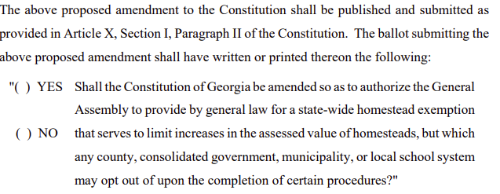
Constitutional Amendment
House Resolution 1022
November 5th Statewide Referendum (HR1022)

Slide 7
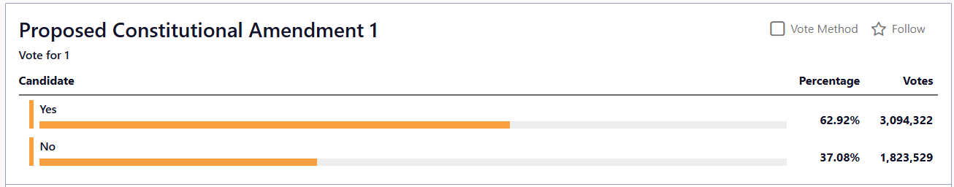
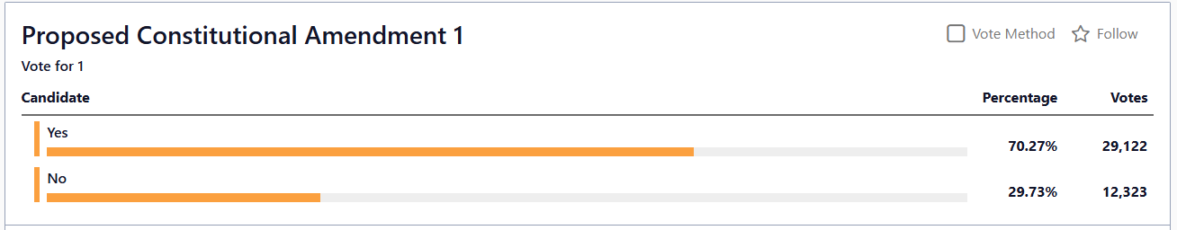
November 5th Voting Results
Statewide Election Results
Barrow County Election Results

Slide 8
Floating Homestead
House Bill 581
What is floating homestead?
A floating homestead is a special type of homestead exemption designed to offset inflationary increases in value.
It is also referred to as a base-year or value offset exemption.

Slide 9
Floating Homestead
House Bill 581
How does it work?
It works by increasing the value of the exemption to offset inflation.
For example, if a property had a taxable value of $100,000 and the taxable value increased the following year due to market changes to $110,000, then the exemption “floats” to be worth $10,000 of the taxable value so the taxpayer still pays on the original base year value of $100,000.

Slide 10
Floating Homestead
House Bill 581
Can the tax assessor’s office continue to adjust my value based on market change?
Yes. Local board of assessors’ offices are required by Georgia law to maintain values that are 10%+/- of what the local real estate market indicates.
For example, if a property had a value of $300,000 and the following year the value changes to $325,000 due to market change, then the exemption “floats” or increases to $25,000 of taxable value so the taxpayer still pays on the original base year value of $300,000.

Slide 11
Floating Homestead
House Bill 581
Does the new “floating” homestead exemption apply to all properties?
The new “floating” homestead exemption is not available to
  Renters
  Commercial and Industrial properties
  Vacant land
Only homeowners who claim a homestead exemption can receive the new “floating” homestead exemption.

Slide 12
Floating Homestead
House Bill 581
Do property owners have to apply for the new floating homestead?
No – All owners receiving a homestead exemption for year 2025 will automatically qualify for the new floating homestead exemption. The base year will be the 2024 final value after all appeals are resolved.
Owners applying for homestead exemption for the 2026 tax year will automatically qualify for the floating homestead exemption, but the base year will be the prior year (2025) value.

Slide 13
Floating Homestead
House Bill 581
Will the HB 581 floating homestead exemption affect counties with existing local home stead exemptions?
NO
Local governments with an existing local homestead exemption will not be affected by HB 581.
The floating homestead exemption is calculated first, and then the non-floating exemptions are calculated on the back end.
“… shall be in addition to and not in lieu of any other homestead exemption applicable to ad valorem taxes.”

Slide 14
Floating Homestead
House Bill 581
What is a “Base Year Value”
For digest year 2024, the Base Year Value will be the final value approved by the board of assessors or appeal.
What is a “Adjusted Base Year Value”
For digest years 2025+, the adjusted Base Year Value is the previous year base value plus or minus any adjustments for additions or removal of real property plus inflationary adjustments authorized by the Georgia Department of Revenue.

Slide 15
Floating Homestead
House Bill 581
What value is used for the base year?
For homes first receiving this exemption in taxable year 2025, the base year will be the final 2024 value.
Base Year

Slide 16

Floating Homestead
House Bill 581
A new owner purchases a property in November of 2024 and applies for homestead exemption by April 1, 2025. What will their taxable value be based on?
The taxable value will be based on the final value for 2024
Base Year

Slide 17
Floating Homestead
House Bill 581
Will the base year always be 2024?
No – for homes first receiving the exemption after 2025, the base year assessed value will be the final value for the immediately preceding year.

Slide 18

Floating Homestead
House Bill 581
A new owner purchases a property in October 2026 and applies for homestead exemption by April 1, 2027. What will their taxable value be based on?
The taxable value will be based on the final value for 2026.
Base Year

Slide 19

Floating Homestead
House Bill 581
A new owner purchases a property in October 2029 and applies for homestead exemption by April 1, 2030. What will their taxable value be based on?
The taxable value will be based on the final value for 2029
Base Year

Slide 20
Floating Homestead
House Bill 581
Are all taxing jurisdictions subject to the new floating homestead exemption?
HB 581 implements a floating homestead exemption for all local governments that DO NOT opt-out on or before March 1, 2025:
      Counties
      Cities
      Schools
      Special Districts

Slide 21
Floating Homestead
House Bill 581
Can a city, county, or school opt-out of the HB 581 floating homestead exemption?
Yes, the opt out process is very similar to the “public notification of tax increase” process when a local government does not take a full rollback.
The local government wanting to opt-out must advertise and hold three public hearings of intent to opt out, pass a resolution opting out and file it with the Secretary of State.
Each local government (county, city, school) may independently make the decision whether to opt out. Any combination may stay in or opt out.

Slide 22

Floating Homestead
House Bill 581
Did any Barrow authorities opt out of the floating homestead?
Yes, the Barrow Board of Education officially opted out of the statewide floating homestead on February 25, 2025.

Slide 23
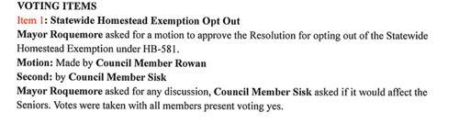
Floating Homestead
House Bill 581
Did any Barrow authorities opt out of the floating homestead?
Yes, City of Auburn officially opted out of the statewide floating homestead exemption on February 27, 2025.

Slide 24

Floating Homestead
House Bill 581
Did any Barrow authorities opt out of the floating homestead?
Yes, City of Statham officially opted out of the statewide floating homestead exemption on February 24, 2025.

Slide 25
Floating Homestead
House Bill 581
How will the Board of Education’s decision to opt-out of the new “floating” homestead affect my county or city tax?
Keep in mind, cities, county and schools are completely independent of one another and cannot influence exemptions or tax rates for a different district.
The school system opting-out of the new floating homestead has no impact on city and county taxes. Citizens will receive the additional benefit of the new exemption in addition to any exemption already in place.
The school system opting out of the new “floating” homestead will not allow additional tax savings to apply to the school’s portion of property tax, due to the school system offering their own exemptions.
The school system opting-out of the new “floating” homestead has no impact on existing school tax exemptions for owners over the age of 62.
The Barrow County Board of Education purposed a new tax exemption that was voted on and went into effect for 2025.

Slide 26

Floating Homestead
House Bill 581
What tax does the floating homestead not apply to?
Ad valorem taxes levied to pay interest on and to retire bonded indebtedness.

Slide 27

Floating Homestead
House Bill 581
How long does the new floating homestead exemption last?
The new statewide floating exemption lasts indefinitely. It would take an additional statewide legislation and a successful statewide referendum to revoke the HB 581 homestead exemption.

Slide 28
Floating Homestead
House Bill 581
How much can I expect to save on my property tax with the new “floating” homestead?
If a property had a value of $300,000 and the following year the value increased due to market changes to $325,000, a person claiming a homestead exemption could expect to see the additional tax savings below.
325,000- 300,000= 25,000 * 40%= 10,000 * millage rate =
School $151.93 Barrow Co. schools opted out of the floating homestead exemption on February 25, 2025
County $42.32
City of Winder $49.63
City of Statham $66.5 City of Statham opted-out of the floating homestead exemption on February 24, 2025
City of Auburn $49.31 City of Auburn opted-out of the floating homestead exemption on February 27, 2025
*Calculations are estimated using the 2025 adopted millage rate for each district

Slide 29

Floating Homestead
House Bill 581
How much land can be included in the floating homestead exemption?
HB 581 did not specify an acreage limit for state homestead exemption, unlike many local homestead exemptions. Therefore, the HB 581 floating homestead exemption will apply to the home, outbuildings/ accessory structures and all acreage associated with the property.
    *** HB92 limited the floating homestead to 5.00 acres and the underlying acreage for CUV-FLPA.***

Slide 30
Floating Homestead
House Bill 581
How is the homestead adjusted for inflation?
HB 581 floating homestead exemption is unique because the base year value will increase or decrease by the consumer price index reported the Department of Labor, Bureau of Labor Statistics for all urban consumer, U.S. city average for the most recent calendar year rate of change and reported by the State Revenue Commissioner.
  If we take the same property with a $100,000 taxable base year value and CPI is 2% the following year, then the base value of $100,000 may be increased by up to 2% to give an adjusted base year value of $102,000. The exemption floats to $8,000 of assessed value so the taxpayer would pay on a taxable value of $102,000 in year 2.

Slide 31
Floating Homestead
House Bill 581
Pursuant to House Bill 581, unless a governing authority of any county, consolidated government, municipality, or school district elected to opt-out of the homestead exemption, each resident of this state is granted an exemption on that person’s homestead from as valorem taxes in an amount equal to the amount by which the current year assessed value of that homestead exceeds its previous adjusted base year assessed value. For clarification purposes, the base year assessed value (which is used to establish the adjusted base year assessed value) for the 2025 Digest Year is the 2024 Digest Year assessed value for all eligible homesteads for the Floating Homestead Exemption. In effect, the assessed value on a person’s homestead will not change from 2024 to 2025. The Inflation Index Rate shall not be used to establish that adjusted base year assessed value until 2026.

Slide 32
Floating Homestead
House Bill 581
How will the taxable values change in 2025?
The HB 581 floating homestead exemption takes effect in 2025 and uses the final 2024 value as the base year value. In 2025, the adjusted base year value is equal to the base year value, which means the digest for homesteaded properties taxable value will not increase from 2024 to 2025.

Slide 33
Floating Homestead
House Bill 581
How will the taxable value change in 2026?
Beginning in 2026 and each year thereafter, the adjusted base year value may be increased or decreased by up to the rate of inflation as determined by the State Revenue Commissioner.
When will an inflationary index be applied to new homestead exemptions received after April 1, 2025?
The inflationary index will always be applied in year two for new homesteaded properties received after April 1, 2025.

Slide 34
Floating Homestead
House Bill 581
What happens if owners receiving homestead exemption make renovations to their home?
The value of the renovation will be added to the homeowner’s base value.
“Substantial property change means any increase or decrease in the assessed value of a homestead derived from additions or improvements to, or the removal of real property from, the homestead which occurred after the year in which the base year assessed value is determined for the homestead. The assessed value of the substantial property changes shall be established following any final determination of value on appeal pursuant to Code Section 48-5-311.”

Slide 35

Floating Homestead
House Bill 581
If a taxpayer's fair market value decreases, will they have to pay tax on the higher amount?
NO
If a taxpayer’s value decreases owners will be taxed at the lower amount.

Slide 36
Floating Homestead
House Bill 581
Can the floating homestead exemption be transferred to another property within the same county?
No – Homestead exemptions are specific to a person and property. If there is a change in the property’s ownership or the owner moves, the exemption will be removed. The property owner will need to apply for the homestead exemption on their new property, and the “base year” will be reset to the previous year value for the property being applied.
HB 581 requires any person granted the floating homestead exemption notify the tax receiver or tax commissioner of the local government or governments in the event such person for any reason becomes ineligible for such exemption.

Slide 37
Floating Homestead
House Bill 581
Can the floating homestead exemption be transferred to a new owner of the home?
The only transfer of the HB 581 floating homestead exemption allowed is to the surviving spouse of the person claiming the homestead.
  The surviving spouse of the person who has been granted the exemption shall continue to receive the exemption so long as such surviving spouse continues to occupy the residence as a homestead.
  For anyone else that acquires the home as a homestead, the base value will be reset to the value for the immediately preceding year, before any exemptions were applied.
        No exemption shall transfer to any subsequent owner of the property.

Slide 38
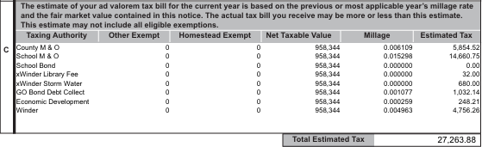
Remove Tax Estimate on the Notice of Assessment
House Bill 581
Estimated Tax
HB 581 removes the “estimated tax” on the notice of assessment (NOA) but adds an “estimated rollback” in its place.
  “Estimated roll-back rate” means the currents year’s estimated millage rate minus the millage equivalent of the total net assessed value added by reassessments.
  The estimated rollback must be certified to the tax commissioner after being submitted by the county and school .
  The cities “estimated rollback” must be certified to the collecting officer.

Slide 39
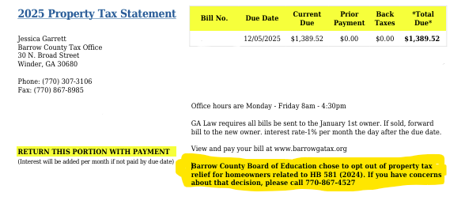
Estimated Rollback
House Bill 581
  If a county, school or city does not roll the millage rate back to the “estimated rollback rate”, a BOLD statement must be printed on a tax bill listing each taxing authority that did not roll millage rate back to offset tax increase.
  “The adopted millage rate exceeds the estimated roll-back rate as stated in the annual notice of assessment that you previously received for this taxable year, which will result in an increase in the amount of property tax that you will owe.”

Slide 40
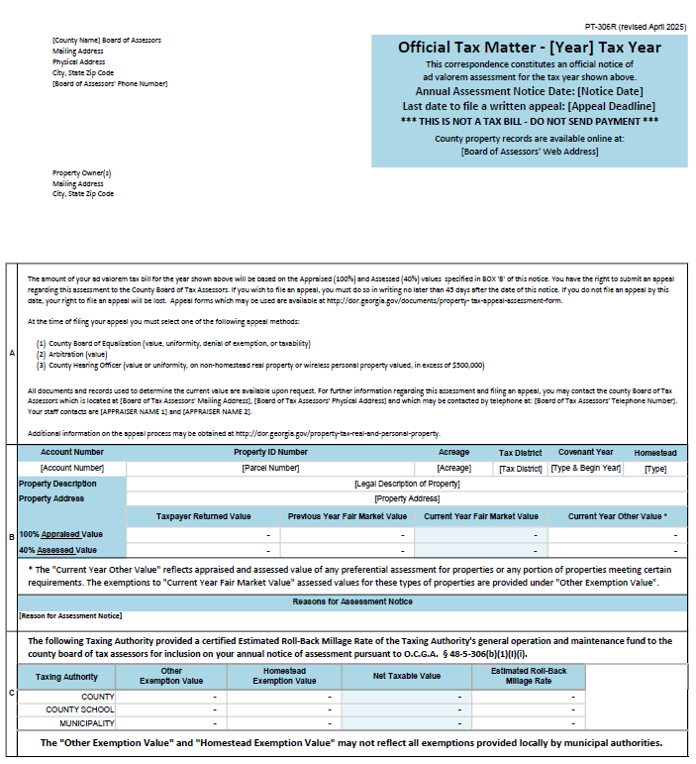
Remove Tax Estimate on NOA
House Bill 581
What will the new assessment notice look like?
The Georgia Department of Revenue has adopted form PT-306R – Used for all levying authorities who provide the estimated rollback rate.

Slide 41
Barrow County Board of Assessors:
Understanding The Annual Notice of Assessment
Property Ownership as of January: Ownership is based on who owns the property on January 1.
Appeal Deadline: You have 45-days to appeal the current market value shown on the assessment notice.
Appeal Rights and Contacts: Information on your rights to appeal and who to reach out to with questions.
Covenant Enrollment: the first year a property enrolls in a 10-year covenant.
Homestead Exemption Code: State and local homestead exemption code including statewide exemption approved by voters in 2024 for governing authorities not opting out on or before March 1, 2025.
Property-Specific Information: Details specific to the property being appraised.
Values: Taxpayer Return Value is an Owners opinion of value, Previous value is last year’s value. Current value is the expected sale price. The 40% assessed values are used for tax calculations.
Current Year Other Value: Total covenant land value for properties enrolled in a covenant.
Property Changed Since Last Year: General information on property changes from the previous year.
Tax Authorities Calculations: Maintenance and operations calculations by tax authorities. These are subject to change based on property tax requirements and/or reassessments of values.
Other Exemptions: Value deductions for agriculture covenants, freeport exemptions, etc.
Homestead Exemption: Value deductions for homestead exemption.
Net Taxable Value: The 40% assessed value minus exemption deductions
Estimated Rollback Millage Rate: If the proposed millage rate from taxing authorities increases property tax, public hearings must be held to inform taxpayers, advertised in the local newspaper and on the authority's website.
2
1
3
4
5
6
7
8
9
10
11
12
13
14
For further information regarding the annual notice of assessment or filing an appeal, you may contact the
Assessor's office which is located at 30 N Broad St, Winder, GA 30680, kwheeler@barrowga.org, or by telephone at: (770) 307 3108

Slide 42
Remove Tax Estimate on the Notice of Assessment
How will I know what my property tax bill will be?
Property tax is calculated using the “Net Taxable Value” times each millage rate adopted by the taxing authorities.
Generally speaking, millage rates are not adopted until August.
Tax bills are typically mailed in September and are due in November.

Slide 43
Estimating Property Tax
Is there a way for owners to estimate their property tax?
The Board of Assessor’s have an easy-to-use Tax Estimator on their website
https://qpublic.schneidercorp.com/Application.aspx?AppID=635&LayerID=11218&PageTypeID=2&PageID=5823

Slide 44
Key Points
House Bill 92
Acreage Limitations
Limits the HB581 floating homestead to 5.00 acres
If property is in Conservation Use (CUVA) or Forest Land Protect Act (FLPA), only the underlying acreage associated with the primary residence is subject to the HB 581 float.

Slide 45

Key Points
House Bill 92
Surviving Spouse and the “Floating Homestead Exemption”
Surviving spouse is eligible to continue the “floating homestead exemption “base year” or “adjusted base year” values without having to reapply for homestead exemption.

Slide 46
Key Points
House Bill 92
HB 581 opt- out
Governing authority will have until March 1, 2025, to opt out
Governing authorities who have opted out shall hold three public hearings, pass a resolution and submit the resolution to the Secretary of State by March 1,2027 to remain opted out of the HB 581 floating homestead.
For 2025, if the governing authority has previously opted-out, they will have until April 30, 2025, to opt back in by filing a resolution with the Secretary of State.
For 2026-2029, if the governing authority has previously opted-out, they will have until March 1, 2029, of such year to opt back in by filing a resolution with the Secretary of State.

Slide 47
Key Points
House Bill 92
Homestead Application Extension
Homestead application can be approved during the 45-day appeal period.
“An applicant seeking a homestead exemption as provided in Code Section 48-5-
44 and qualifying under the provisions of Code Section 48-5-40 shall file a written
application and schedule with the tax receiver or tax commissioner charged with
the duty of receiving returns of property for taxation at any time during the
calendar year subsequent to the property becoming the primary residence of the
applicant up to and including the date for the closing of the books for the return
of taxes for the calendar year, except that, in the case of a property which is
subject to a reassessment by the board of tax assessors, such application and
schedule may be filed in conjunction with or in lieu of an appeal of the
reassessment.”

Slide 48
Key Points
House Bill 92
Notice of Assessment Change
If a levying authority does not provide the estimated rollback rate to the Board of Assessors and the tax commissioner, their previous years millage and estimated tax for the current year goes on the NOA.
“(ii) For each levying or recommending authority that did not certify its estimated roll-back rate to the county board of tax assessors and county tax commissioner by the date specified in Code Section 48-5-306.2, the millage rate that was actually levied by or on behalf of such authority for the previous tax year, and an estimate of the amount of ad valorem taxes due for the assessed property based on such millage rate and the amount of the current assessment."

Slide 49
Key Points
House Bill 92
Estimated rollback timeline
Each levying shall certify the estimated rollback rate to the county Board of Tax Assessors and county tax commissioner no less than 15 days prior to the postmark of the annual NOA
“Each levying and recommending authority shall annually calculate its estimated roll-back rate for the current year and shall certify such rate to the county board of tax assessors and county tax commissioner no less than 15 days prior to the postmark of the annual notice of assessment."

Slide 50
HB 581 and HB 92 Summarized
• Established a statewide floating homestead exemption limited to the primary
residence, 5.00 acres or for CUV/FLPA properties, the excluded underlying acreage
for residence.
• The 2024 final value will be the “base year” value for 2025.
• Department of Revenue shall adopt an inflationary adjustment to be applied to
existing “base year” exemptions for year 2026.
• Allows governing authority to opt-out of statewide exemption on or before March
1, 2025
• If an authority has opted-out, they have until March 1, 2029 to opt back in.
• Levying authority must provide the estimated millage rate rollback to the BOA &
TCO no less than 15 days of the postmark of the notice of assessment to avoid
having their estimated tax on the notice.
• Allows property owners to file for homestead exemption during the 45-day appeal
period
• Department of Revenue has adopted a new assessment notice.

Slide 51
Who should owners contact if they have questions?
Owners are more than welcome to contact the Board of Assessors office, and they will be more than happy to assist.
Phone 770-307-3108
Email Kwheeler@barrowga.org
Office 30 N Broad St, Winder Ga 30680

